Slide 1
In-Country Data Manager
Central Office Data Processing Training
Notes:
Importance of paper/content first, CAPI second
Testing programs, learning the flow
Preparation – setting up CAPI system to control for interviewers, sample cluster and household identification (done by [CONTRACTOR] Data Manager)
Central Office – led by In-Country Data Manager

Slide 2
FTF CAPI System
Computer-assisted personal interview (CAPI)
A system to help interviewers, supervisors, quality control teams, and the Central Office collect, supervise, and monitor the fieldwork operation
Written in CSPro language
Four systems in CAPI operations:
Preparation: field teams, clusters, households
Interviewers: data collection
Supervisor: track fieldwork progress
Central Office/Quality Control & Support Teams: monitor fieldwork quality
Notes:
Importance of paper/content first, CAPI second
Testing programs, learning the flow
Preparation – setting up CAPI system to control for interviewers, sample cluster and household identification (done by [CONTRACTOR] Data Manager)
Central Office – led by In-Country Data Manager

Slide 3







Interviewer System
Updates, module sharing,
transfer data to supervisor
Supervisor System
Supervisor
Supervisor
Central Office
System
Reports
Central Office (ICDM)
Notes:
Central Office (CAPI) is led by the in-country Data Manager
All red and black arrows indicate transfer of data and/or updates to systems. For arrows between supervisor and interviewers (and between interviewers), Bluetooth is used. For all other arrows, internet transfer is used.
For module sharing, updates, transferring data, all is WITHIN teams (teams don’t share outside of themselves)

Slide 4




Interviewer System Components
Menu application
Household interview
Identify required modules
Module sharing
Module interviews
Enter anthropometry data
Identify eligible women, children
Backup to flash memory devices
Transfer data to supervisors/share data with the team
Get updates from supervisor
Backup memory cards
Int1
Int2
Int5
Data/update transfer
Supervisor

Slide 5






Supervisor System Components
Menu application
Assign households to interviewers
Receive data from interviewers daily
Keep track of status for every household
Check data structure
Report overall summaries for the cluster
Send to Central Office using Dropbox
Receive and distribute system updates
Backup data to flash memory devices
Data/update transfer
Supervisor
Backup
Central Office (ICDM)

Slide 6


Central Office System Components
Menu application
Receive clusters from supervisors via Dropbox
Reports and structure checking by cluster
Run secondary editing programs by cluster and modify errors
Run field check tables
Monitor fieldwork operation by cluster or team
Review interviewer notes
Supervisor 1
Supervisor 2
Supervisor n
Central Office (ICDM)

Slide 7
Central Office Flow
Cluster is closed in the field
View/modify questionnaires, review field notes
Receive questionnaires
Close cluster
Check structure of data
Produce field check tables
Conduct secondary editing
Produce cluster status report
Notes:
Data processing and finalization at the central office is done at the cluster level

Slide 8
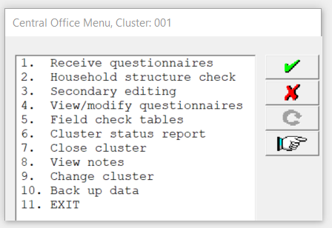
Central Office Menu

Slide 9
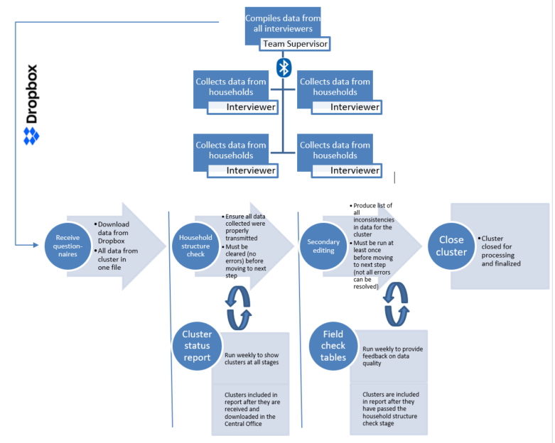
Overall Data Processing Flow

Slide 10
Receive Questionnaires
Cluster is closed in the field
Receive questionnaires
As clusters are closed in the field, ICDM will be alerted to new clusters to download from Dropbox when opening the menu.
Option 1 downloads the data automatically from Dropbox.

Slide 11
Household Structure Check
Check structure of data
Ensure that all applicable survey modules were completed in all households and that all were properly transferred.
Option 2 runs a structure check report at the cluster level.
If there are any issues, immediately contact field teams!

Slide 12
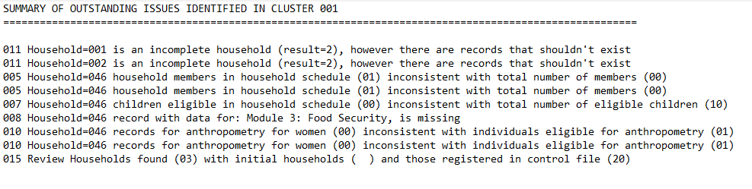
Household Structure Check
While rare, all outstanding issues MUST be resolved.
(See guidance in the ICDM manual.)
Notes:
Requires hands-on training!

Slide 13
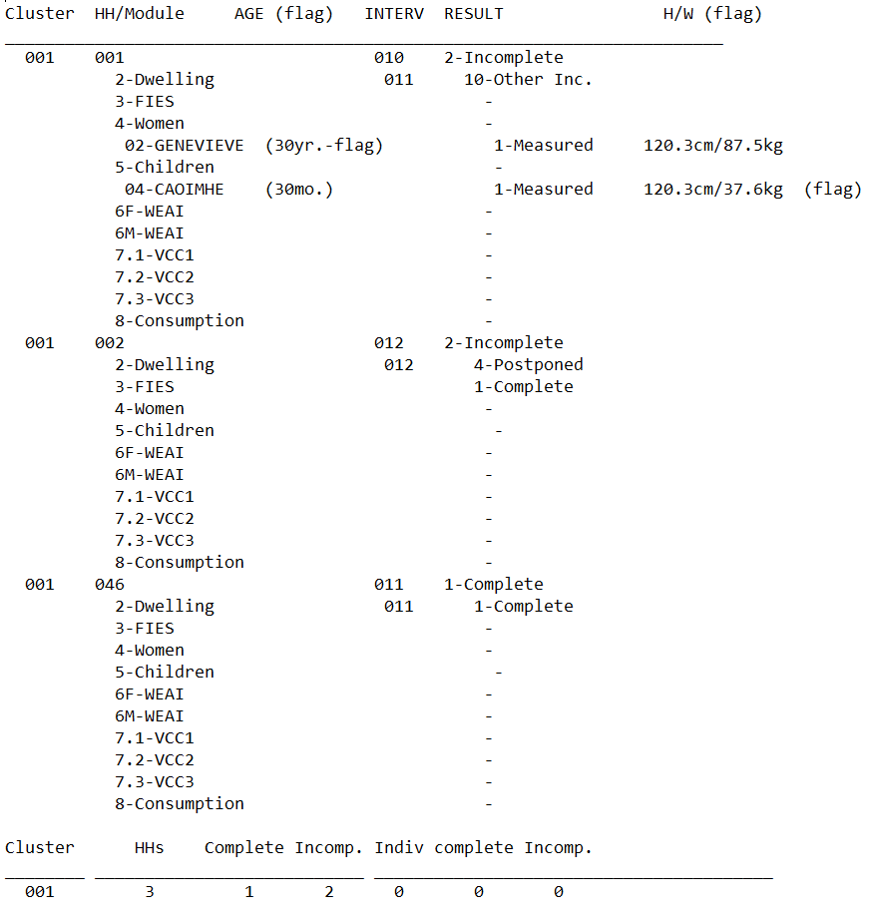
Household Structure Check
If clean, a list of households and modules will appear.
Notes:
Requires hands-on training!

Slide 14
Secondary Editing
Conduct secondary editing
Secondary editing is the most time-consuming activity for ICDM.
Option 3 produces a listing of potential inconsistencies or errors in household data that could not easily be checked or resolved in the field.

Slide 15
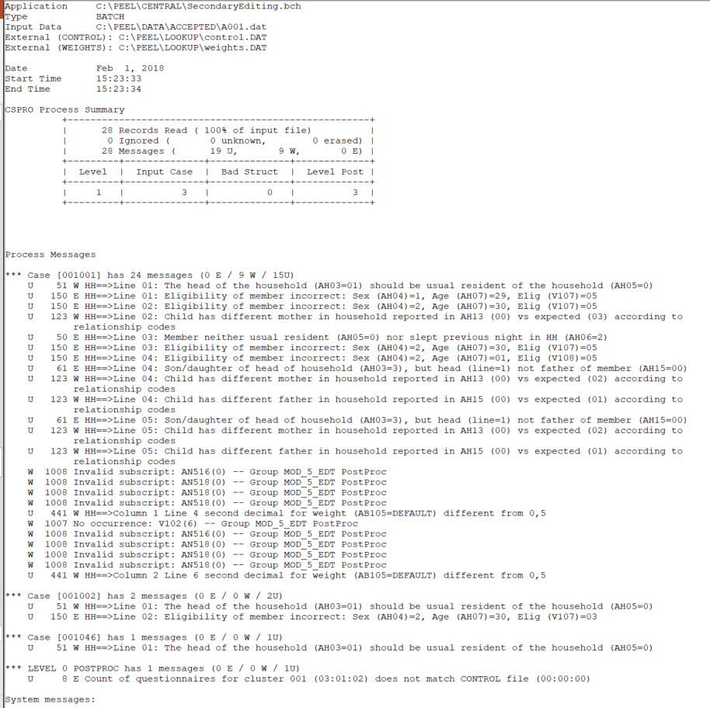
Secondary Editing
Use secondary editing manual to determine whether data should be edited or whether the message should be marked “ok.”
Must run listing at least once, and not all errors require an edit to the data!
Notes:
Requires hands-on training!

Slide 16
View/Modify Questionnaires, Notes
View/modify questionnaires, review field notes
Option 4 enters the questionnaires for review and modification from secondary editing reports.
Option 8 displays all notes recorded by field teams during data collection—must be reviewed.

Slide 17
Close Cluster
Close cluster
After all secondary editing messages have been reviewed and edits made only where necessary, the cluster must be closed.
Option 7 closes the cluster, indicating that all data processing is complete.

Slide 18
Field Check Tables
Produce field check tables
Option 5 produces a set of field check tables for all clusters that have passed the household structure check.
Must be run and reviewed at least once a week and sent to survey management and the [CONTRACTOR] Data Manager.

Slide 19
Cluster Status Report
Produce cluster status report
The report tracks the status of clusters through Central Office data processing and finalization.
Must be run and sent to the [CONTRACTOR] Data Manager at least once a week.

Slide 20
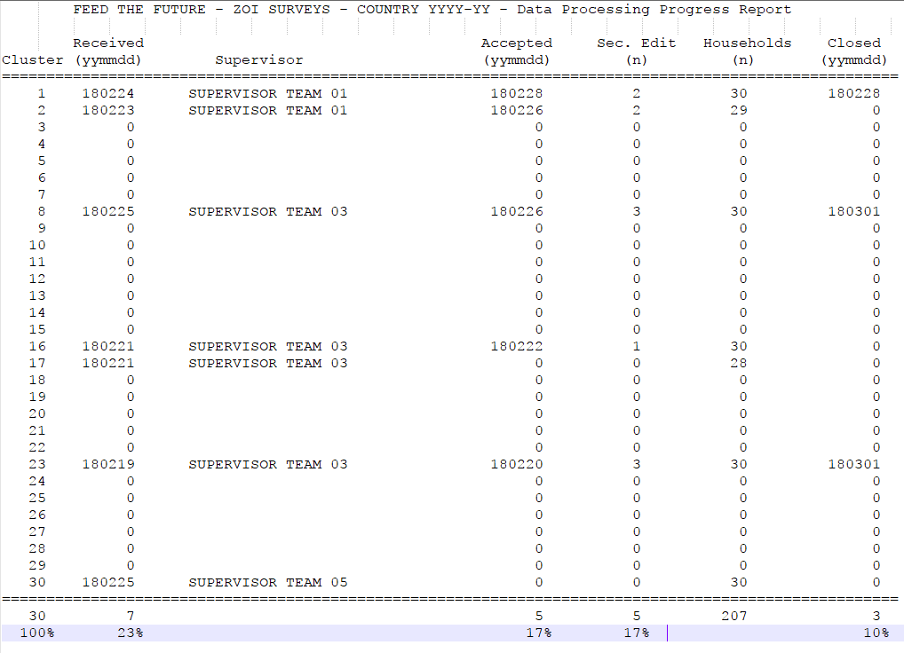
Cluster Status Report

Slide 21
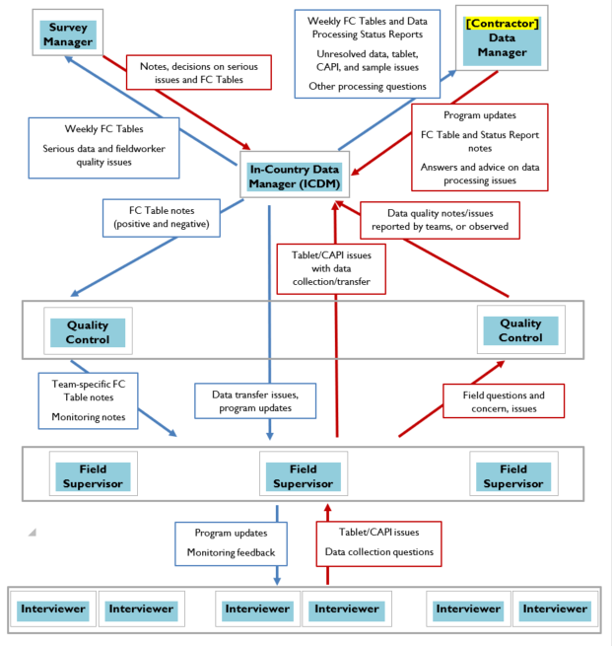
Communication
Do not hesitate to reach out to the [CONTRACTOR] Data Manager with any questions.
See the ICDM manual for further detail.

Slide 22
Disclaimer:
This publication was prepared for review by the United States Agency for International Development. It was prepared for the Bureau for Food Security, United States Agency for International Development, USAID Contract Number GS-23F-8144H/AID-OAA-M-12-00006.
The authors’ views expressed in this publication do not necessarily reflect the views of the United States Agency for International Development or the United States government.
Recommended Citation:
Dupuis, Genevieve. 2018. Feed the Future Survey Methods Guidance: In-Country Data Manager - Central Office Data Processing Training Slides. Washington, DC: Bureau for Food Security, U.S. Agency for International Development.
Contact Information:
Feed the Future
1300 Pennsylvania Ave, NW
Washington, DC 20004
www.feedthefuture.gov

